Slide 1
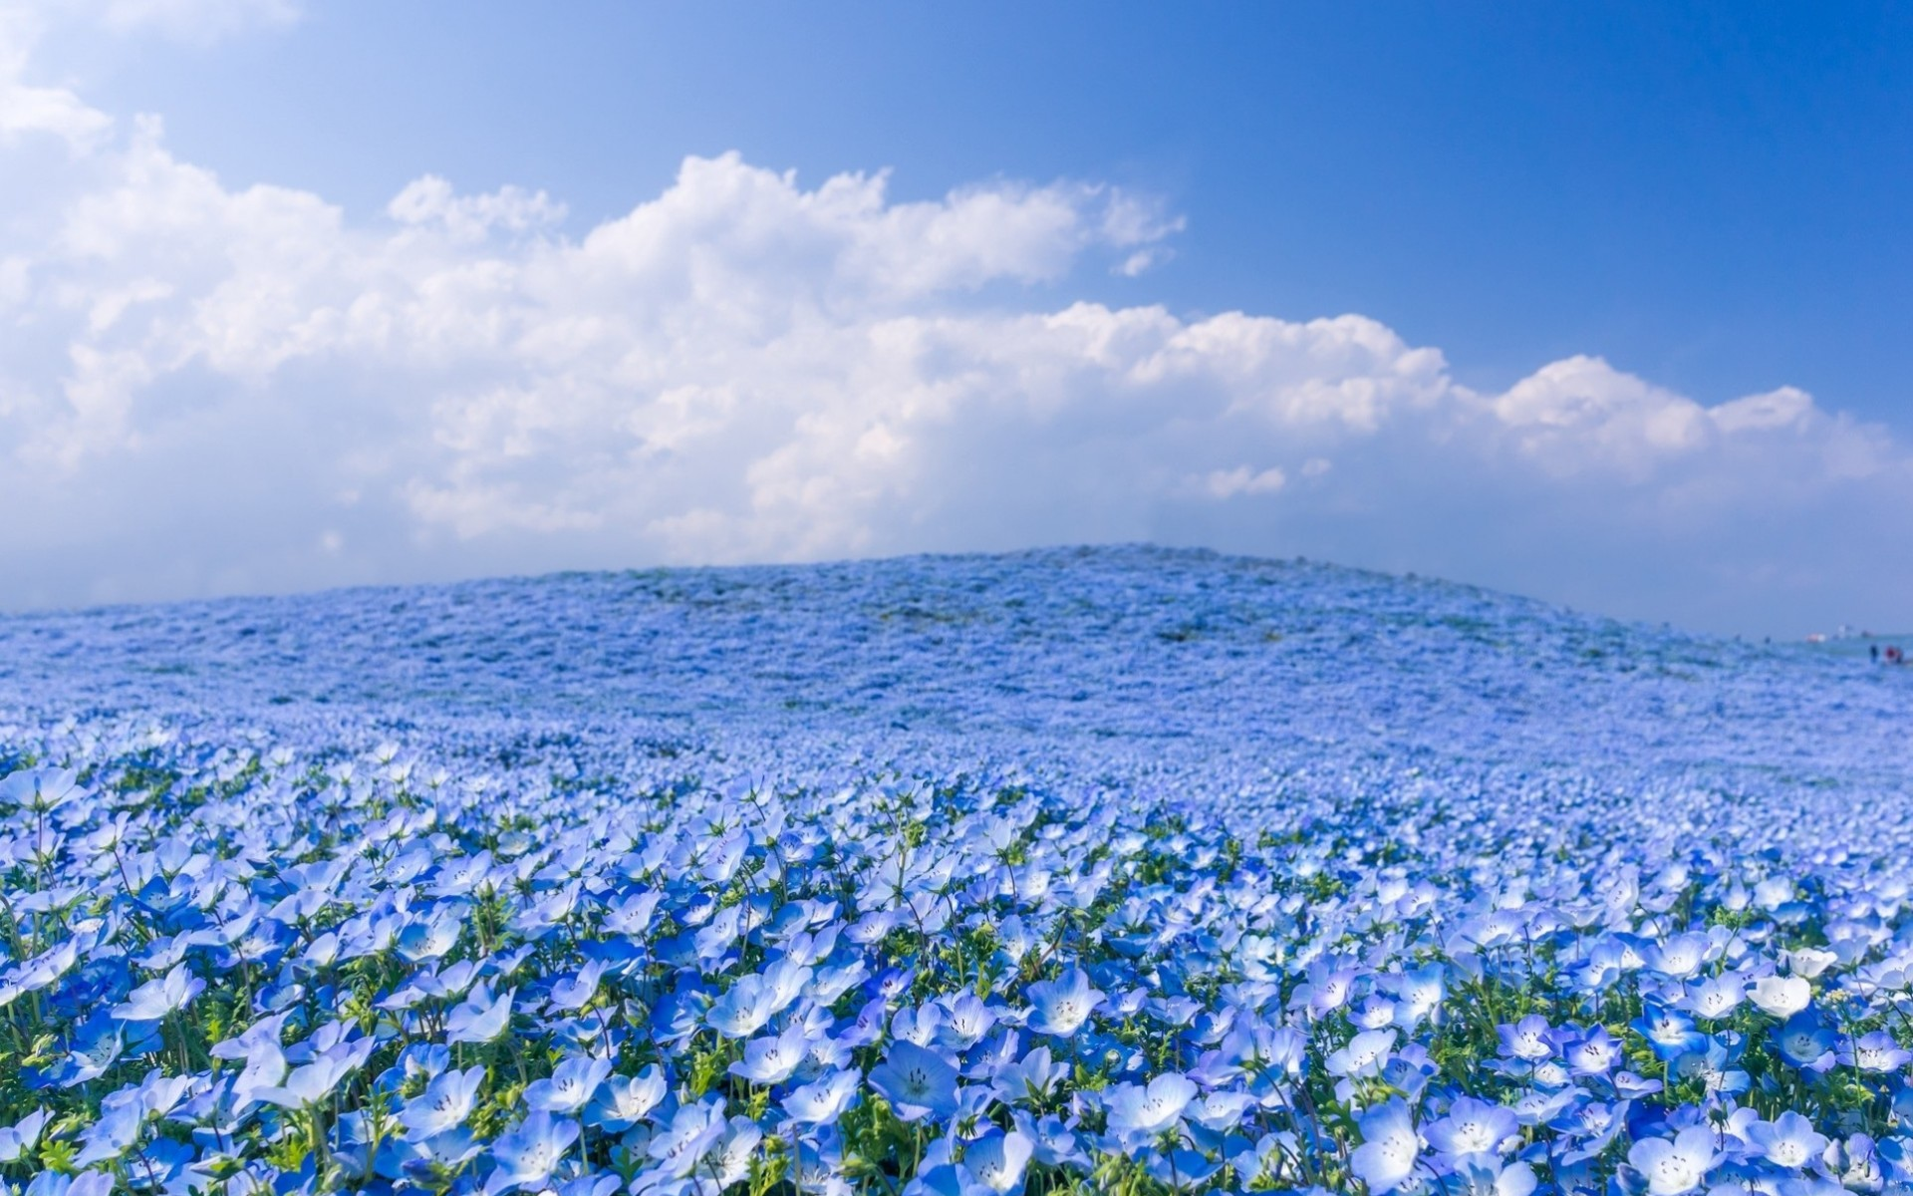

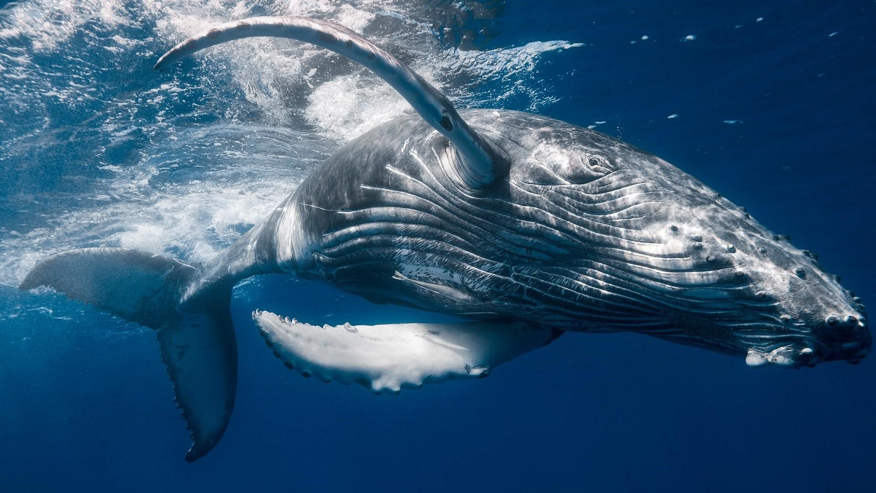
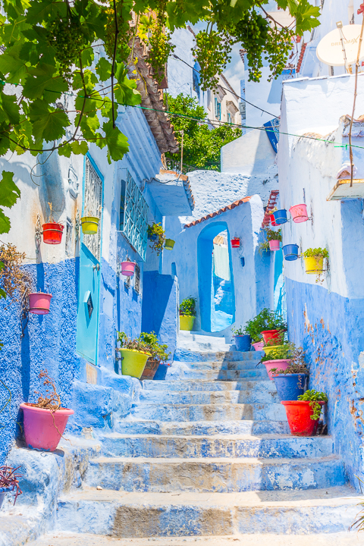
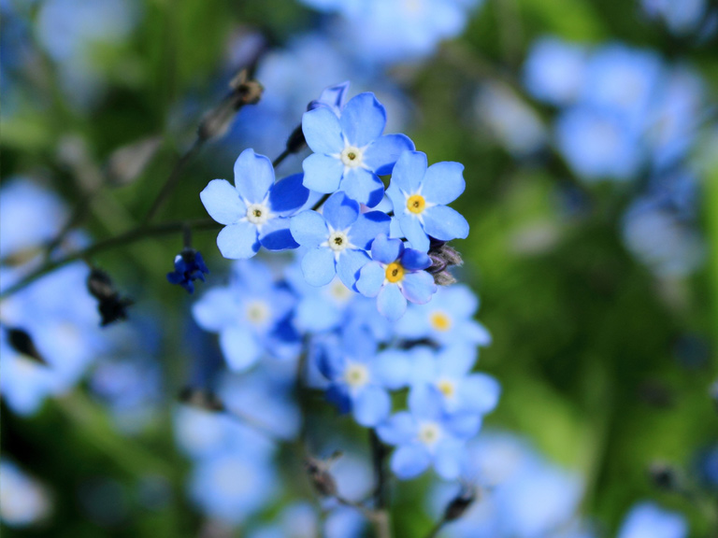
HA
design
FEATURED
BLOOMING
B.lue

Slide 2

HA
design
FEATURED
BLOOMING
WILD
B.lue
STAIRS
DELICACY

Slide 3
hmppt
design
FEATURED
BLOOMING
B.lue
GREAT
COLLECTION
I don’t know what to write here because this is just an
example, so miaw miaw I guess
STAIRS
DELICACY
WILD
IKAN MASIN
RETURN WITH DULEX VERSION

Slide 4
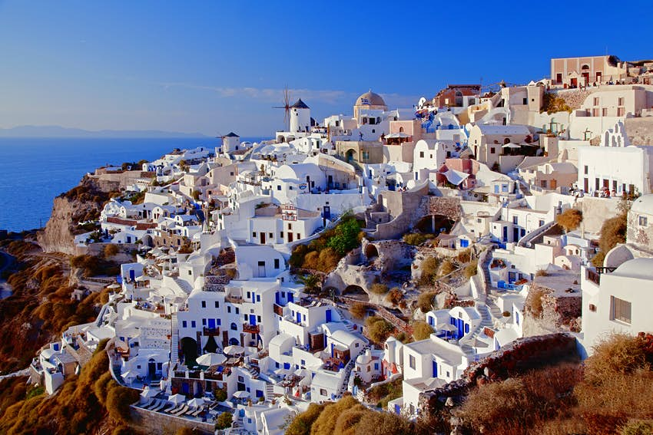
FEATURED
BLOOMING
HA
design
B.lue
GREAT
COLLECTION
I don’t know what to write here because this is just an
example, so miaw miaw I guess
i-cAN MA-SIN
RETURN WITH DULEX VERSION
Blue
stairs
DELICACY
WILD
STAIRS
style
Earth is the 3rd planet in our solar system. Does that
&
Why do a literature review? Reviewing the literature lets you see
what came before, and what did and didn't work for other
researchers. To demonstrate your understanding, and your ability
to critically evaluate research in the field. To provide evidence that
may be used to support your own findings.
fancy
Greece (Greek: Ελλάδα, Elláda, [eˈlaða]), officially the Hellenic Republic,[b] is a country located in Southeast Europe. Its population is approximately 10.7 million as of 2018; Athens is its largest and capital city, followed by Thessaloniki. Situated on the southern tip of the Balkans,

Slide 5

GREAT
IKAN MASIN
RETURN WITH DULEX VERSION
COLLECTION
I don’t know what to write here because this is just an
example, so miaw miaw I guess
Blue
stairs
Earth is the 3rd planet in our solar system.
what came before, and what did and didn't work for other
may be used to support your own findings.
style
fancy
&
classy
classy
Classy is a word used to describe people, places or things, that have a lot of "class." But a classy person isn't just someone who wears expensive clothes.

Slide 6
Blue
stairs
Earth is the 3rd planet in our solar system. Does that
Why do a literature review? Reviewing the literature lets you see
what came before, and what did and didn't work for other
researchers. To demonstrate your understanding, and your ability
to critically evaluate research in the field. To provide evidence that
may be used to support your own findings.
style
fancy
&
classy
Classy is a word used to describe people, places or things, that have a lot of "class." But a classy person isn't just someone who wears expensive clothes.
classy

